Slide 1

DATA ANALYSIS
SAKILA MOVIE RENTAL STORE DATA USING SQL
By- Bhuwan

Slide 2
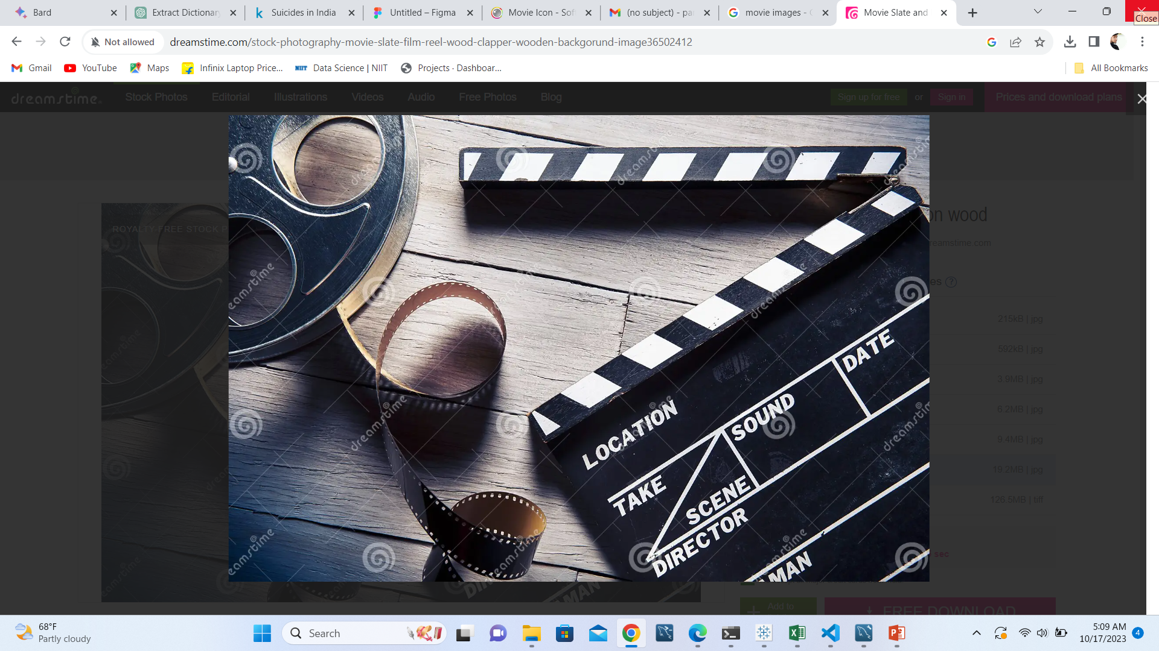
oVERVIEW
MovieOnRent is a chain of movie renting store operating in certain countries.
The Management wants to analyze what kind of movies most often rented, which genres they belong to and which actors appeared on them
The analysis of this data help to stock up the inventory of the movies to improve the business.

Slide 3
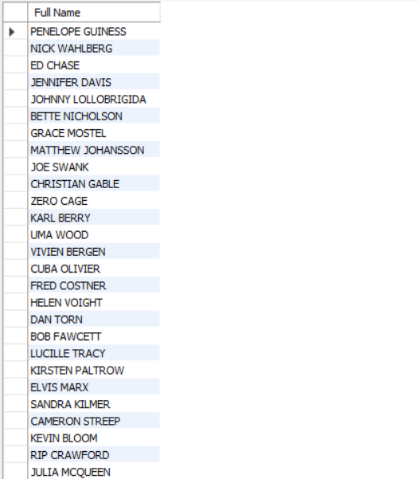
FULL NAMES of ALL the actors IN THE DATASET
Query
Select concat(first_name,' ', last_name) as'Full Name' from actor;
Interpretation
There are 200 different actors in the database.

Slide 4
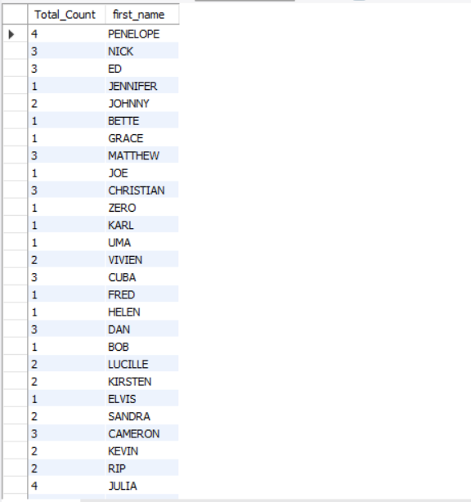
Number of times each first name appeared in the dataset
Query
select count(first_name) as Total_Count, first_name from actor group by first_name;
Interpretation
Actor with Penelope has most number of movies(4)

Slide 5
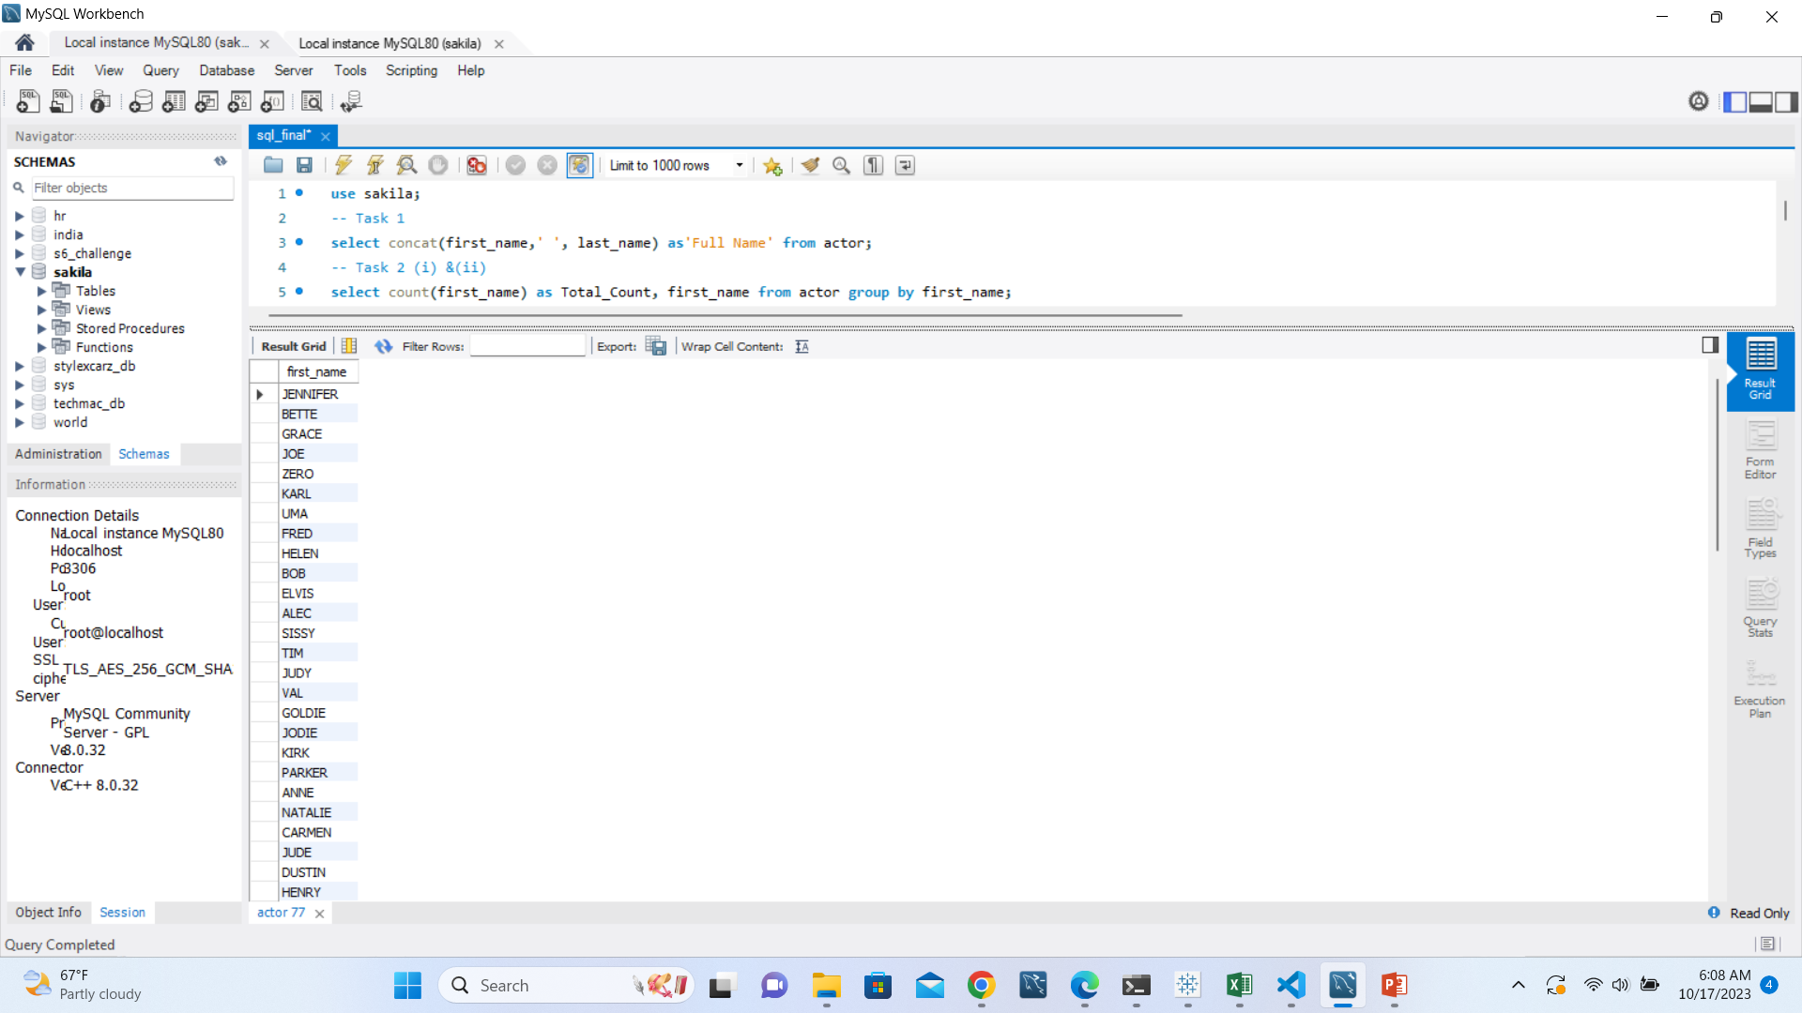
First name of actors those have unique first name
Query
select first_name from actor group by first_name having count(first_name)=1;
Interpretation
There are 128 actors with unique first name

Slide 6
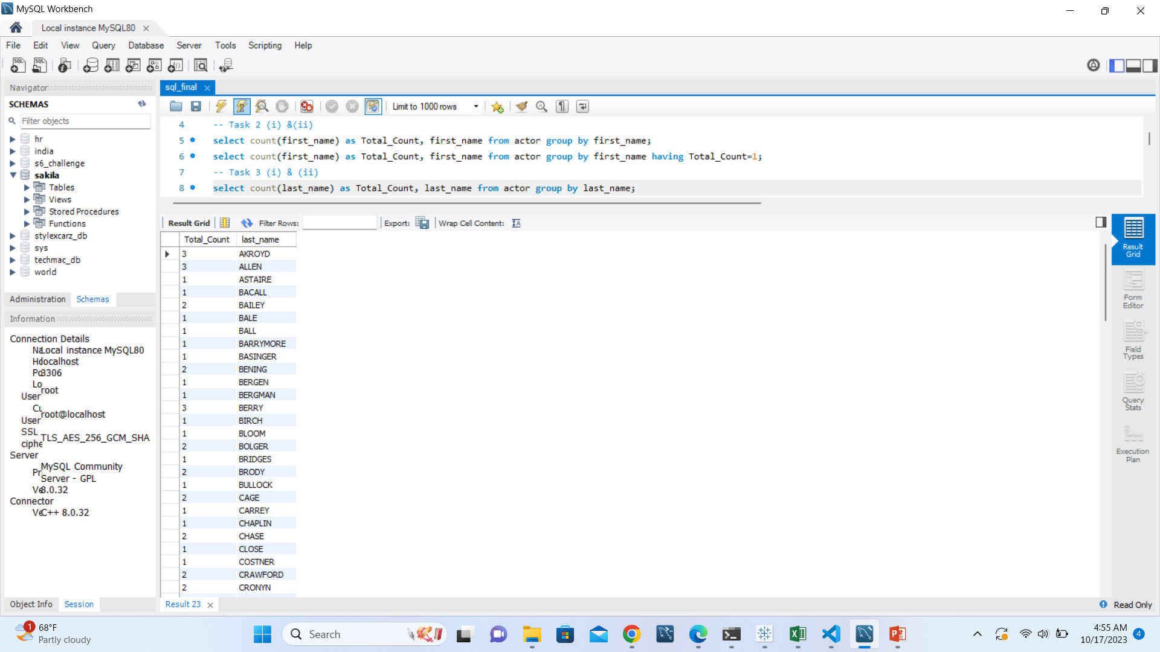
Number of time each last name appeared in the dataset.
Query
select count(last_name) as Total_Count, last_name from actor group by last_name;
Interpretation
Actor with Akroyd last name has most number(3) of movies

Slide 7
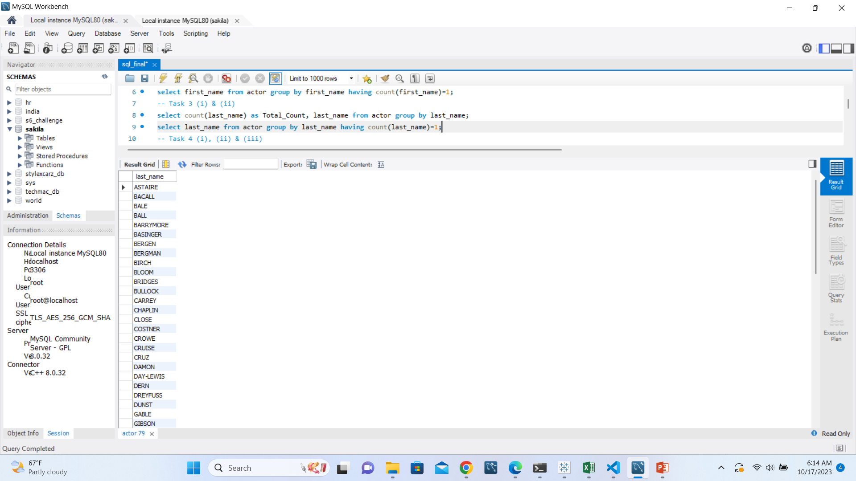
Unique last name in the dataset
Query
select last_name from actor group by last_name having count(last_name)=1;
Interpretation
There are 121 actors with unique Last name

Slide 8
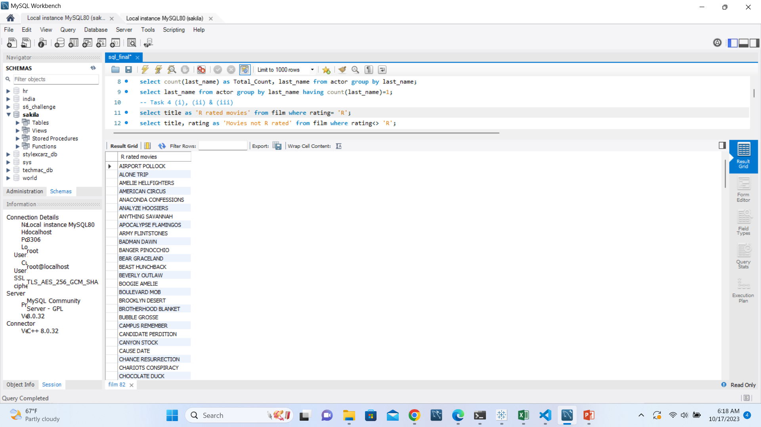
Movies with r rating
Query
select title as 'R rated movies' from film where rating= 'R';
Interpretation
There are 195 R rated movies In the database

Slide 9
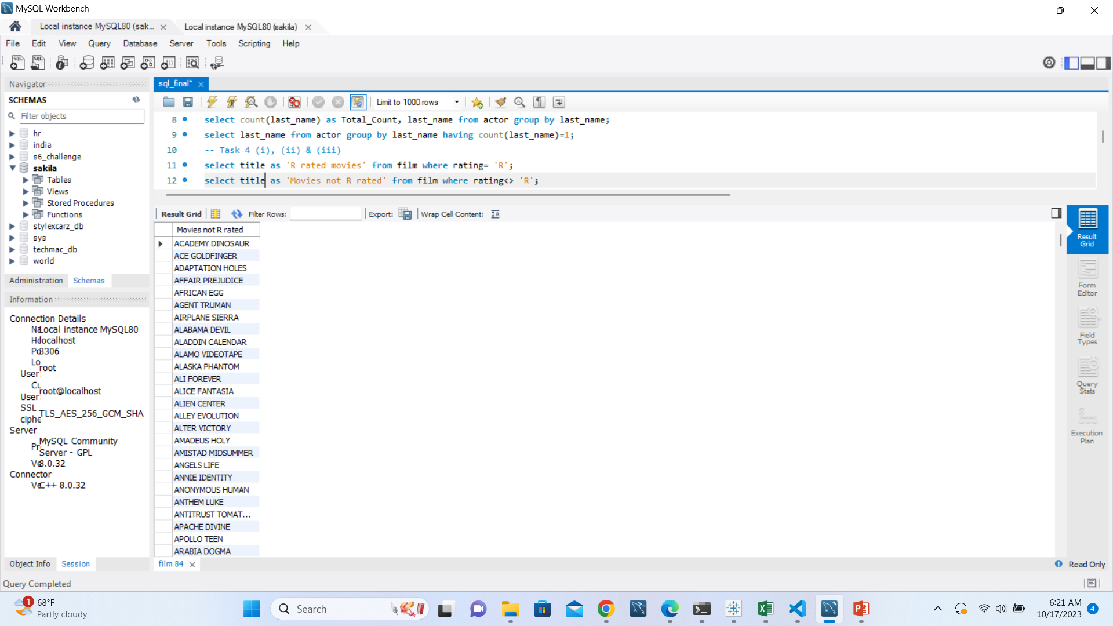
Movies that are not r rated
Query
select title as 'Movies not R rated' from film where rating<> 'R';
Interpretation
There are 805 movies that are not R rated.

Slide 10

MOVIES SUITABLE FOR CHILDREN BELOW 13
select title as 'Movies for children' from film where rating= 'PG-13';
Interpretation
There are 223 movies that are suitable to watch for children below 13
Query

Slide 11
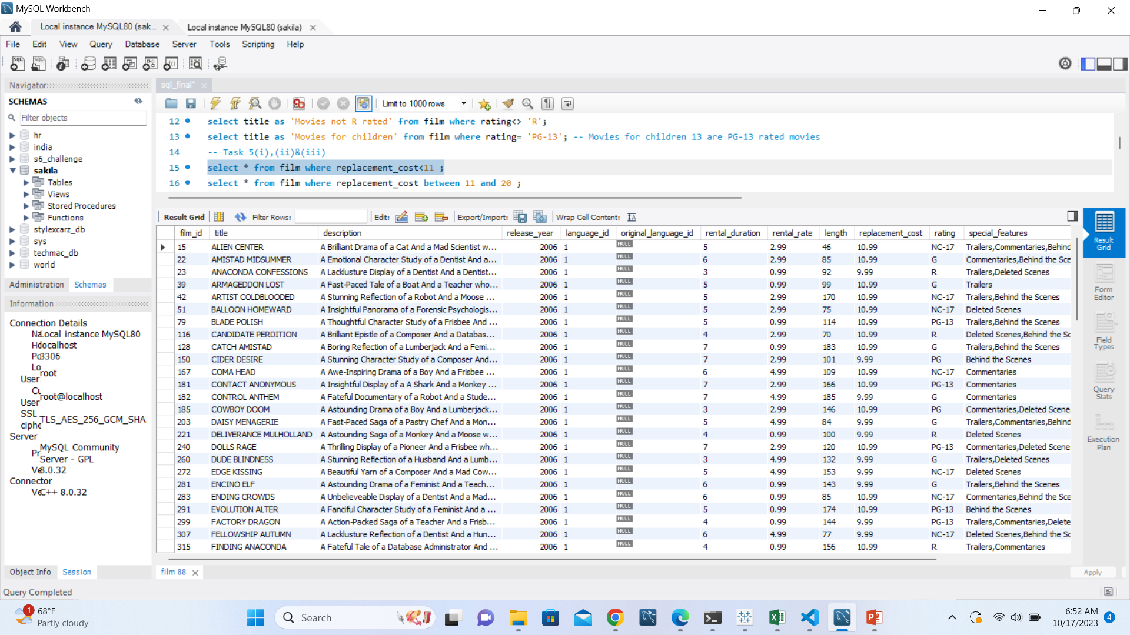
Movies with replacement cost up to $12
Query
select * from film where replacement_cost<11 ;

Slide 12
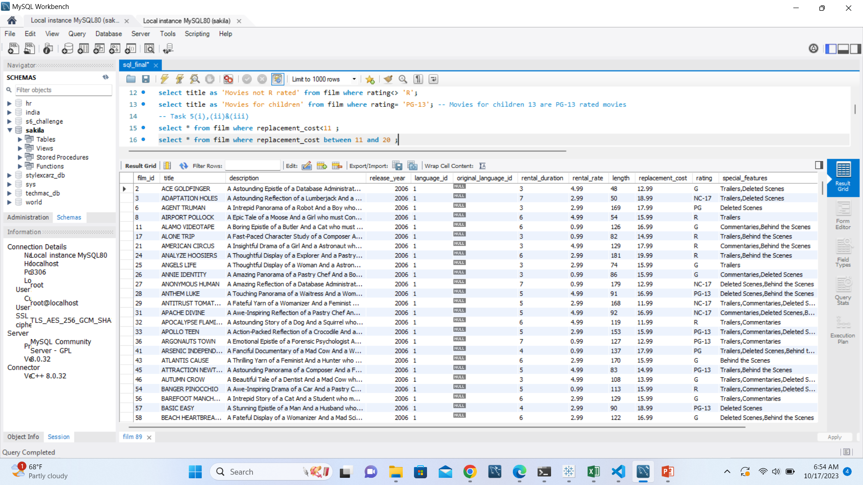
Replacement cost between $11 and $20
Query
select * from film where replacement_cost between 11 and 20 ;

Slide 13
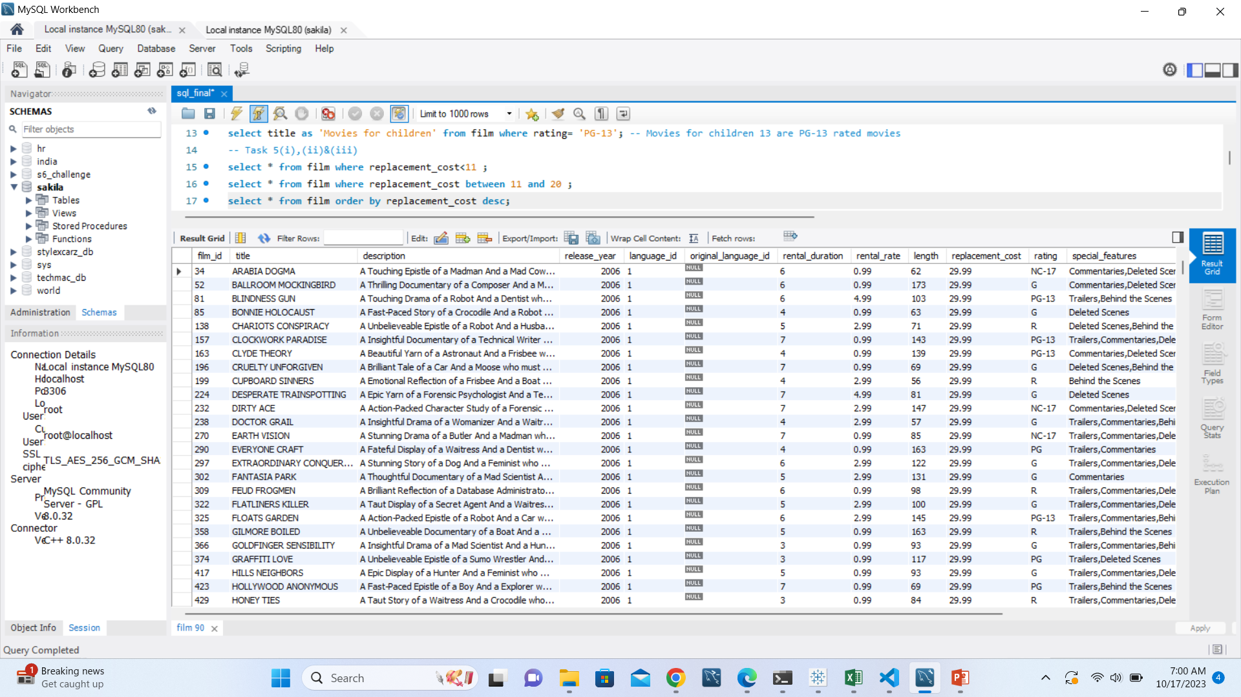
Movies in descending order of their replacement cost
Query
select * from film order by replacement_cost desc;

Slide 14
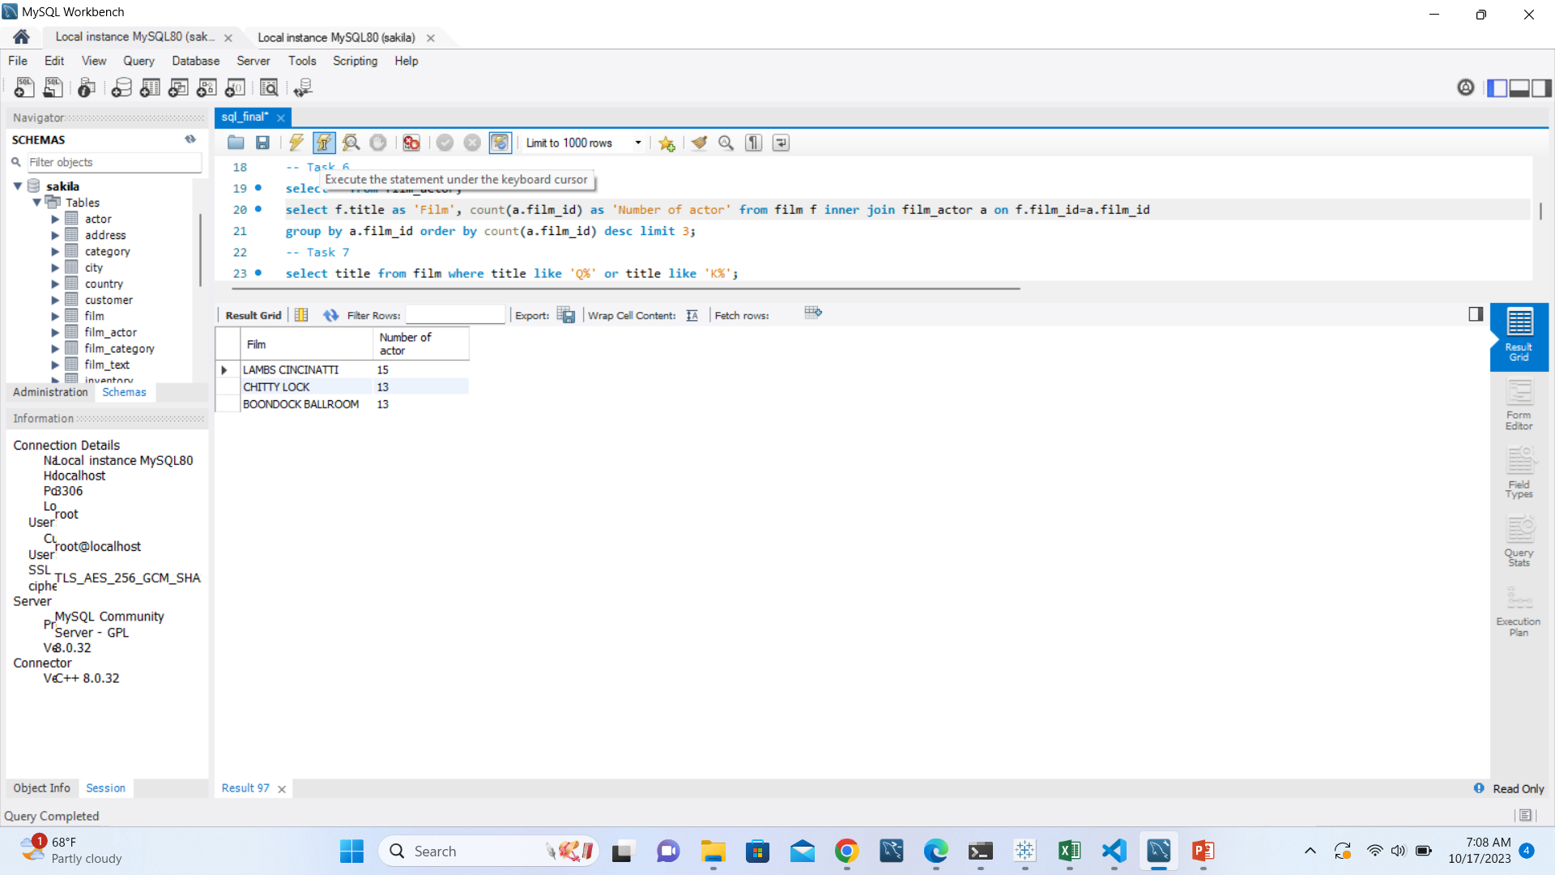
Top 3 movies with most number of actors
Query
select f.title as 'actor', count(a.film_id) as 'Number of actor' from film f inner join film_actor a on f.film_id=a.film_id group by a.film_id order by count(a.film_id) desc limit 3;
Conclusion
Lambs Cincinnati has most (15) number of actors.

Slide 15
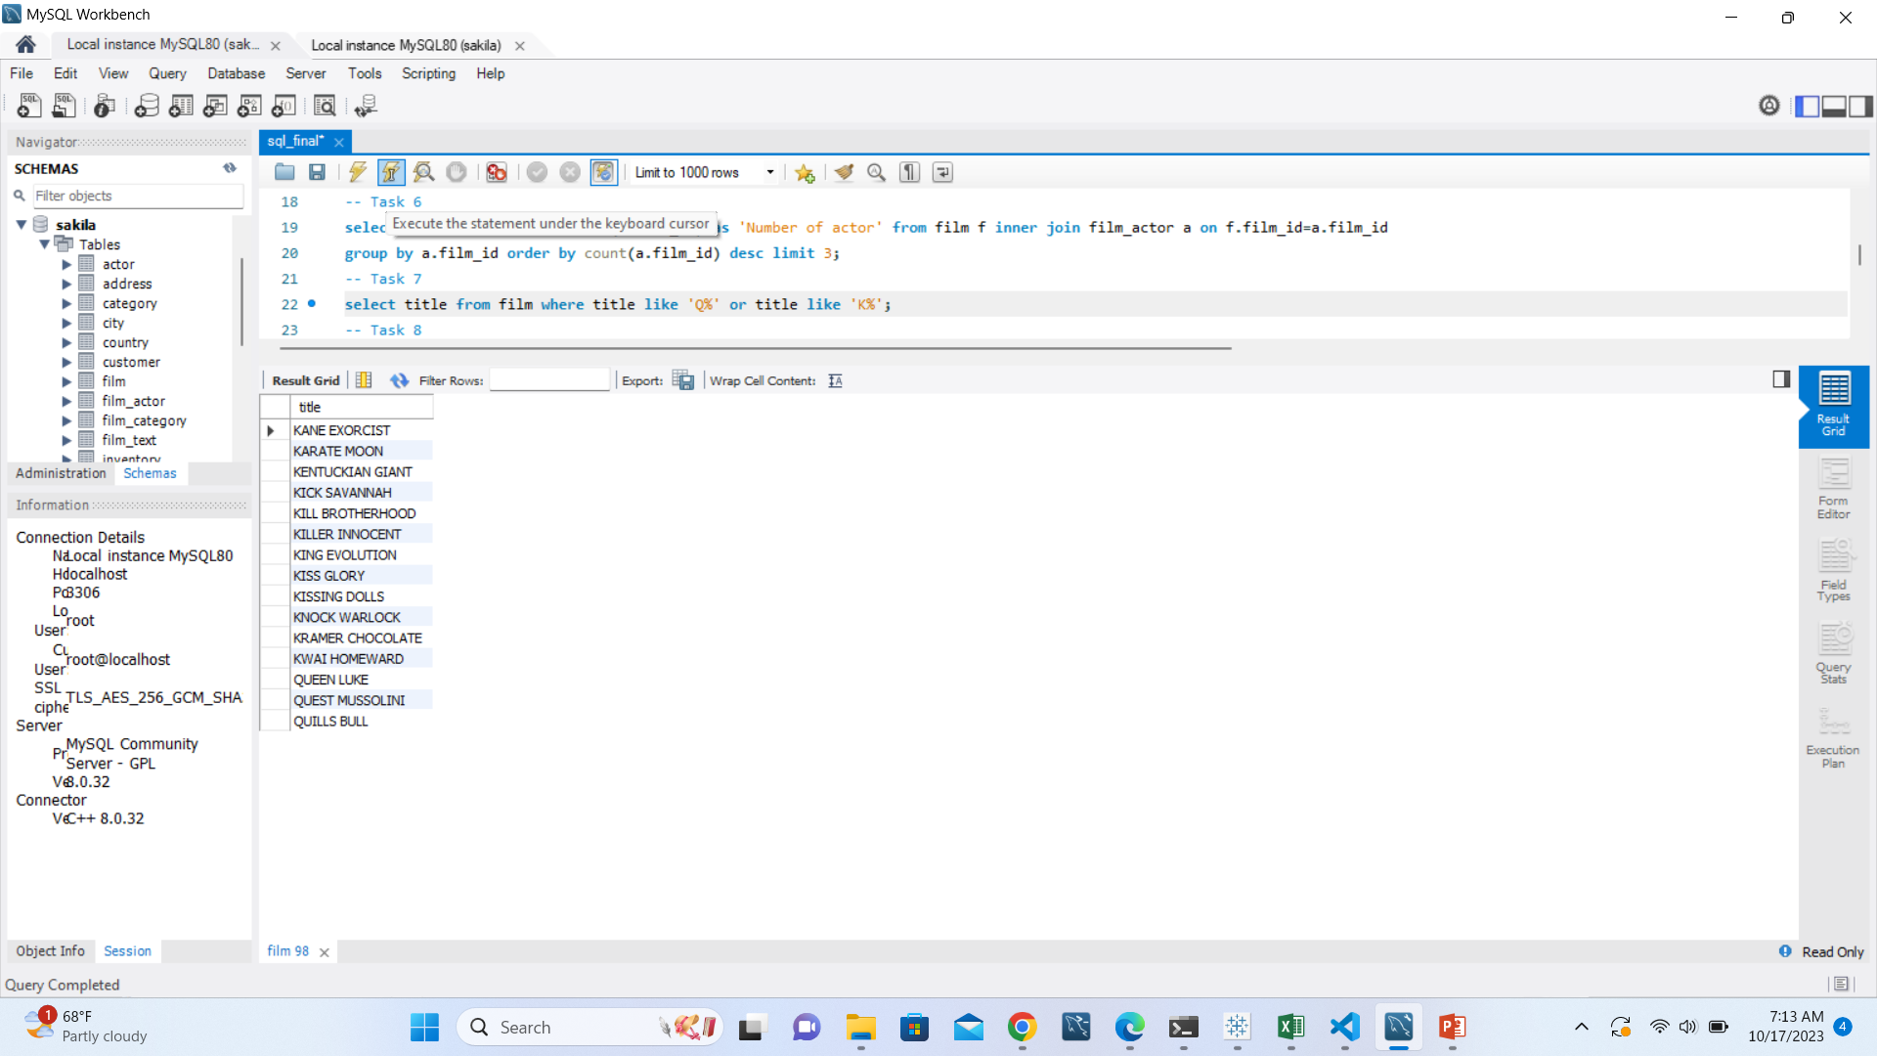
Movies starting with letter k and q
Query
select title from film where title like 'Q%' or title like 'K%';
Interpretation
There are 15 movies whose title starts with K and Q

Slide 16
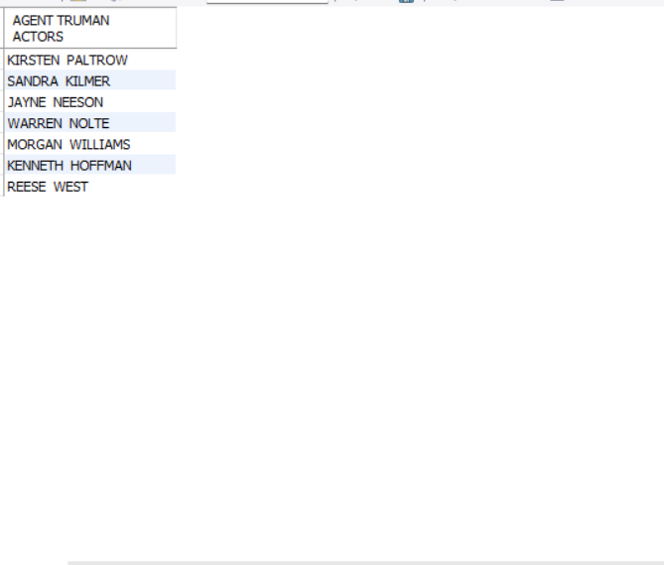
Agent Truman actors
Query
select concat(first_name,' ', last_name) as 'AGENT TRUMAN ACTORS' from film inner join film_actor using (film_id) inner join actor using (actor_id) where title = 'Agent Truman';
Interpretation
There are 7 actors in movie Agent Truman

Slide 17
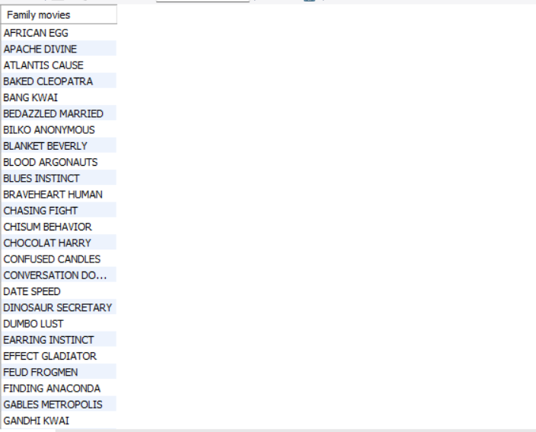
Family movies
Query
select title as 'Family movies' from film inner join film_category using (film_id) inner join category using (category_id) where name ='Family';
Interpretation
There are 69 family category movies.

Slide 18
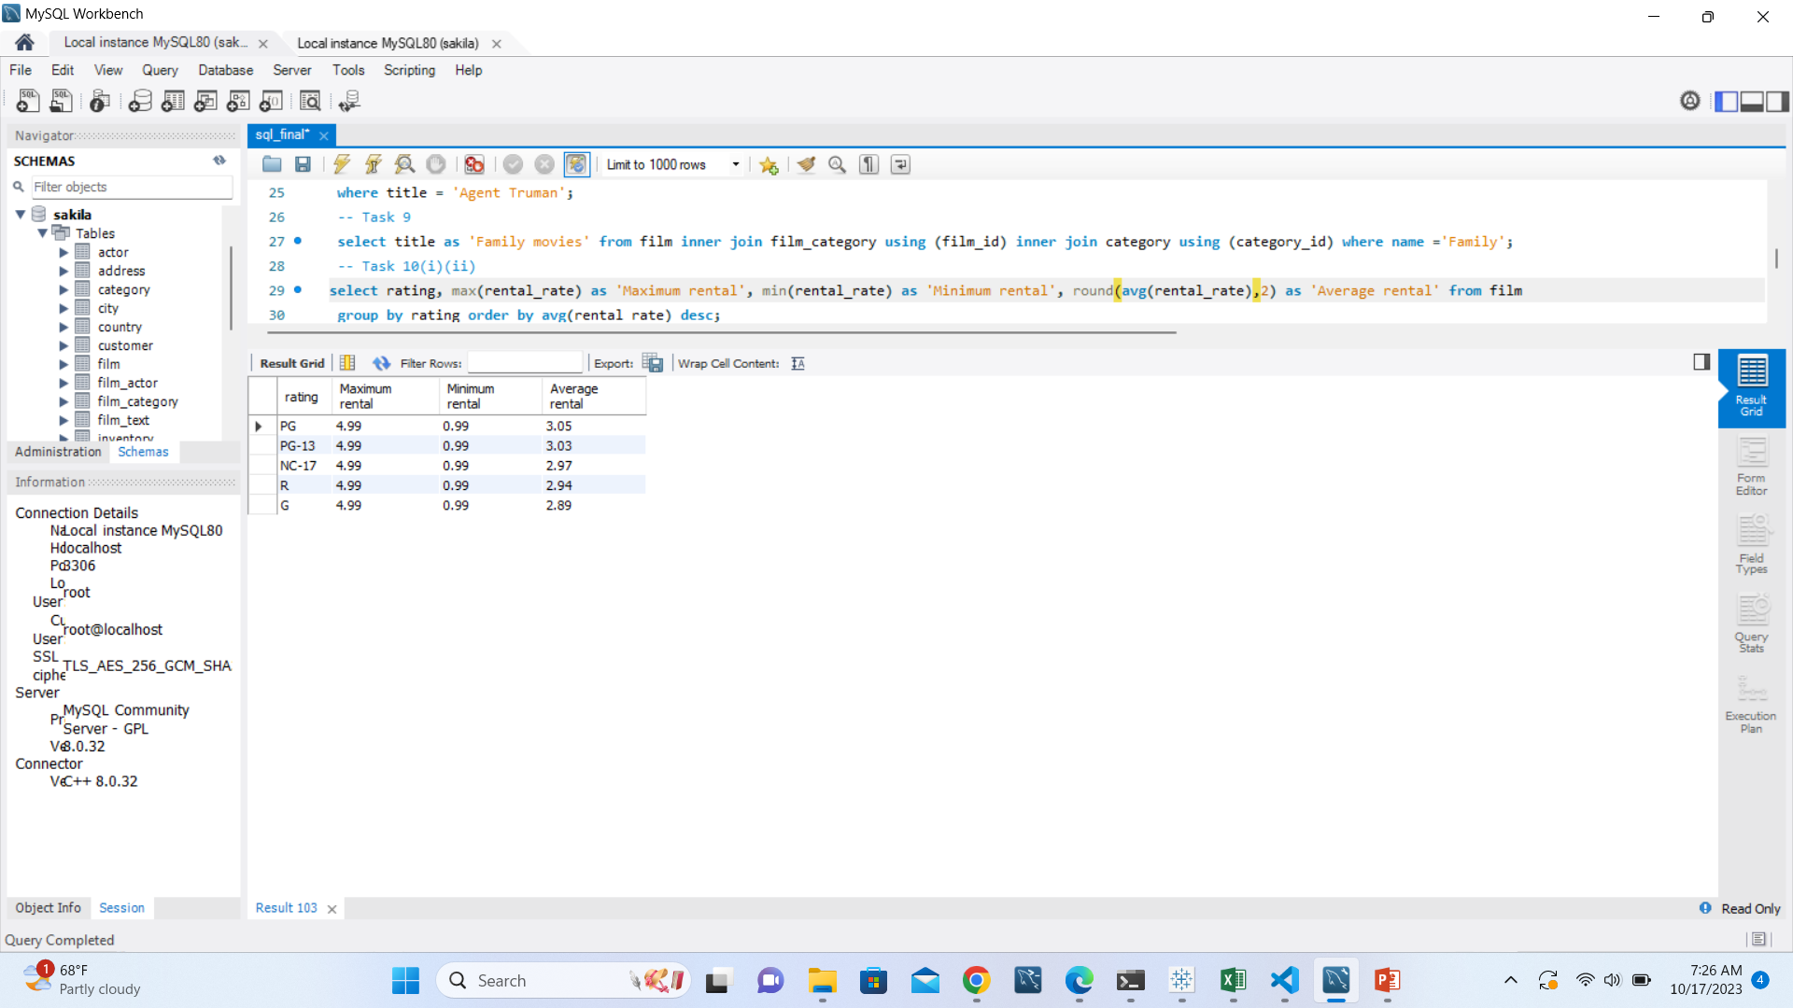
Minimum, maximum and average rental rates of movies based on there ratings
Query
select rating, max(rental_rate) as 'Maximum rental', min(rental_rate) as 'Minimum rental', avg(rental_rate) as 'Average rental' from film group by rating order by avg(rental_rate) desc;
Conclusion
G rated movies has lowest average rental rate(2.89)

Slide 19
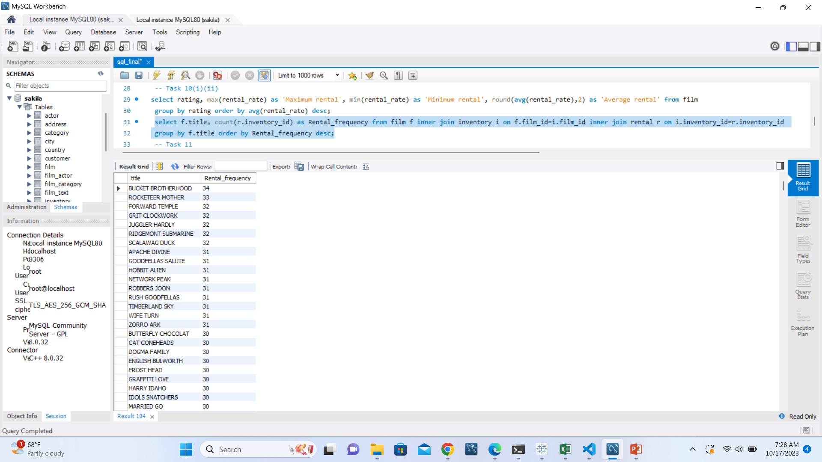
Movies in descending order of their rental frequency
Query
select f.title, count(r.inventory_id) as Rental_frequency from film f inner join inventory i on f.film_id=i.film_id inner join rental r on i.inventory_id=r.inventory_id group by f.title order by Rental_frequency desc;
Interpretation
Bucket brotherhood has the maximum(34) rental frequency

Slide 20
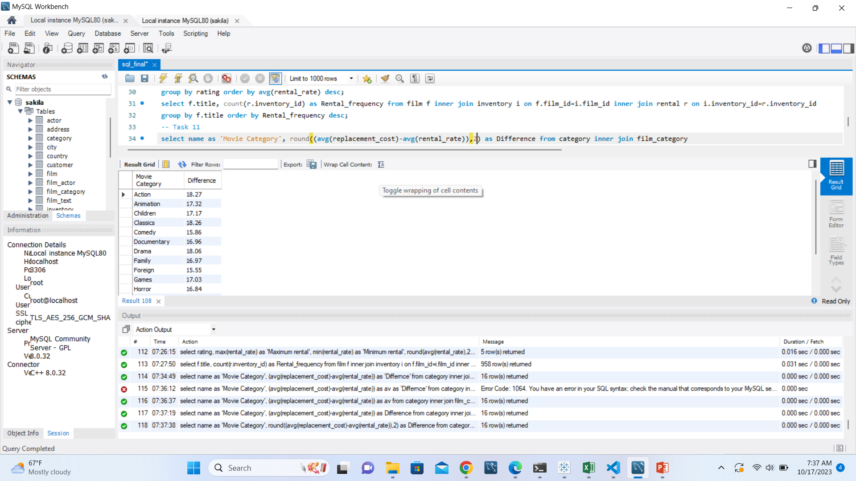
Film category where difference between average rental rate and average replacement cost is greater than $15
Query
select name as 'Movie Category', round((avg(replacement_cost)-avg(rental_rate)),2) as Difference from category inner join film_category using (category_id) inner join film using (film_id) group by name having Difference>15;
Interpretation
Action movie category has highest difference between avg rental and avg replacement cost($18.27)

Slide 21
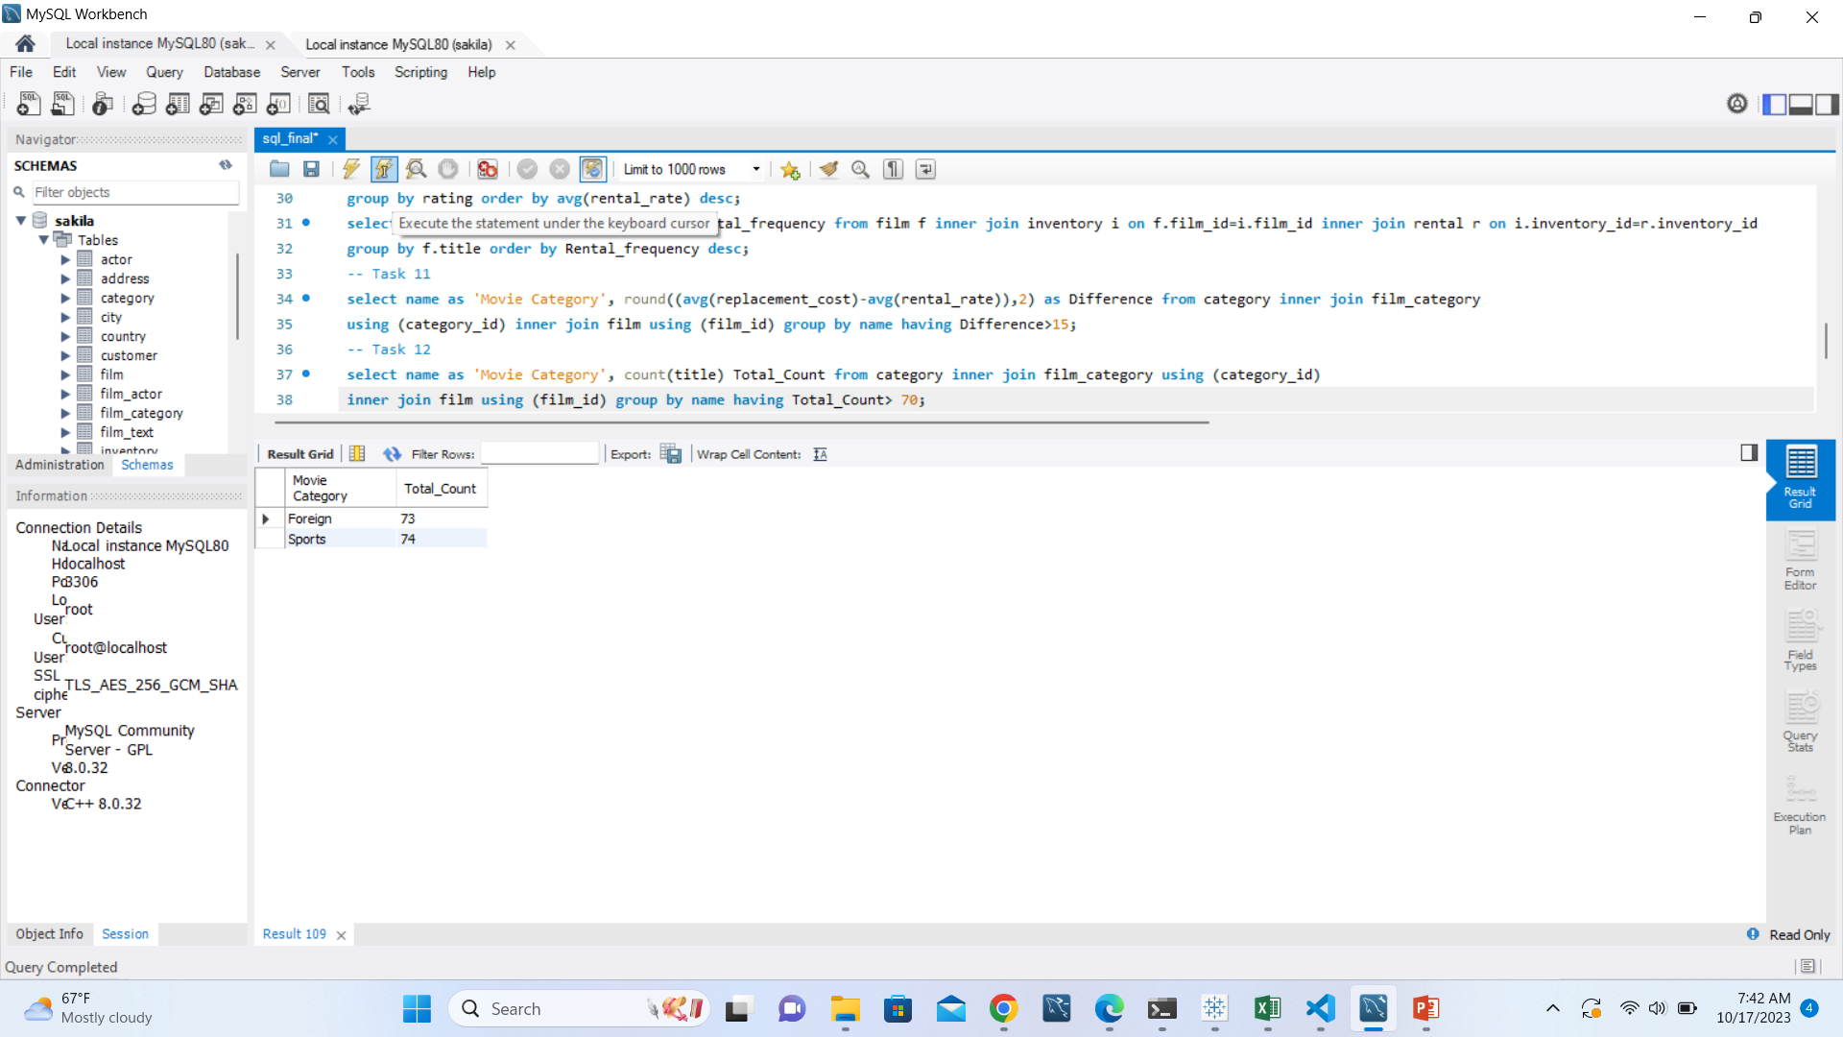
Categories where movies greater than 70
Query
select name as 'Movie Category', count(title) Total_Count from category inner join film_category using (category_id) inner join film using (film_id) group by name having Total_Count> 70;
Interpretation
Highest number of movies are of Sports(74) category, followed by foreign(73), and only these category has movies greater than 70.

